Slide 1
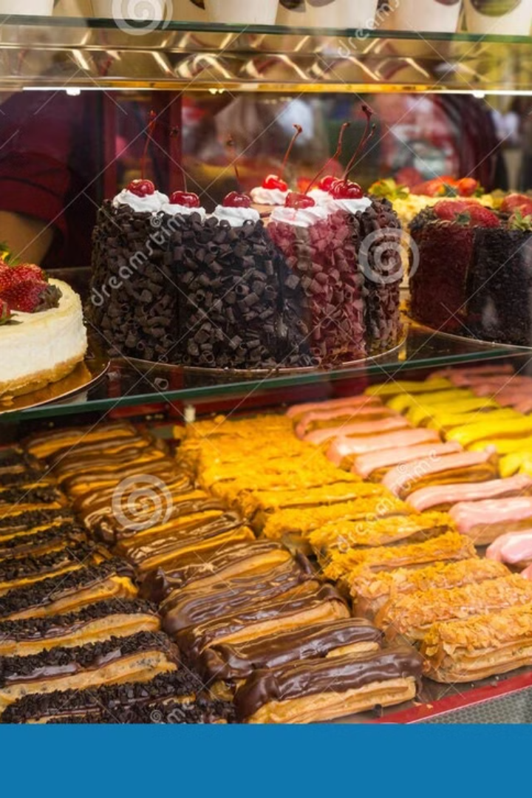
Cake Shop Website: Delicious Desserts.
Welcome to our presentation outlining the development of a captivating website for your cake shop. We'll explore the essential aspects of internet programming and web development, highlighting how we'll create a digital experience that showcases your delectable treats and entices customers to order online.
Presented By, M. Afrina Begam (192210431) Amritha Shree .B (192211185)

Slide 2
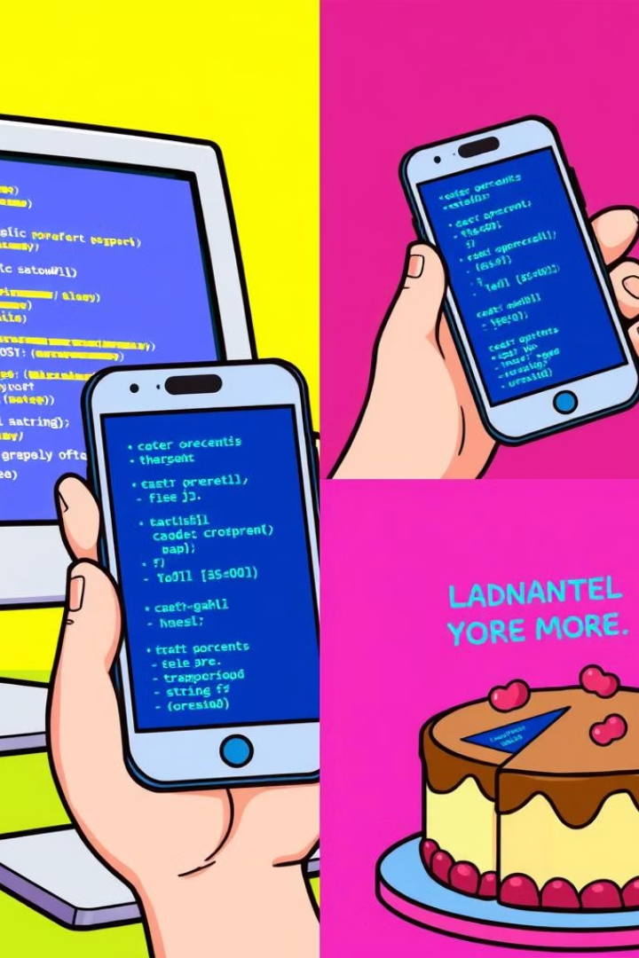
Introduction to Internet Programming
1
Understanding the Internet
2
Client-Server Model
Explore the client-server architecture, where websites respond to user requests. We'll understand how your website will interact with users' devices.
We'll delve into the fundamental concepts of the internet, explaining how data is transmitted and how websites function.
3
Communication Protocols
4
Web Technologies Overview
Learn about essential protocols like HTTP, which enable communication between websites and users' web browsers.
Gain a comprehensive understanding of the core technologies involved in web development, including HTML, CSS, and JavaScript.

Slide 3
Fundamentals of Web Development
Front-End Development
Back-End Development
Full-Stack Development
This area focuses on the user interface (UI) and user experience (UX), what users directly see and interact with on your website.
This involves the server-side logic, databases, and functionality that powers the website's operations and user interactions. We'll discuss how data is stored and managed.
This encompasses both front-end and back-end development, allowing for a comprehensive understanding of the entire website development process.

Slide 4
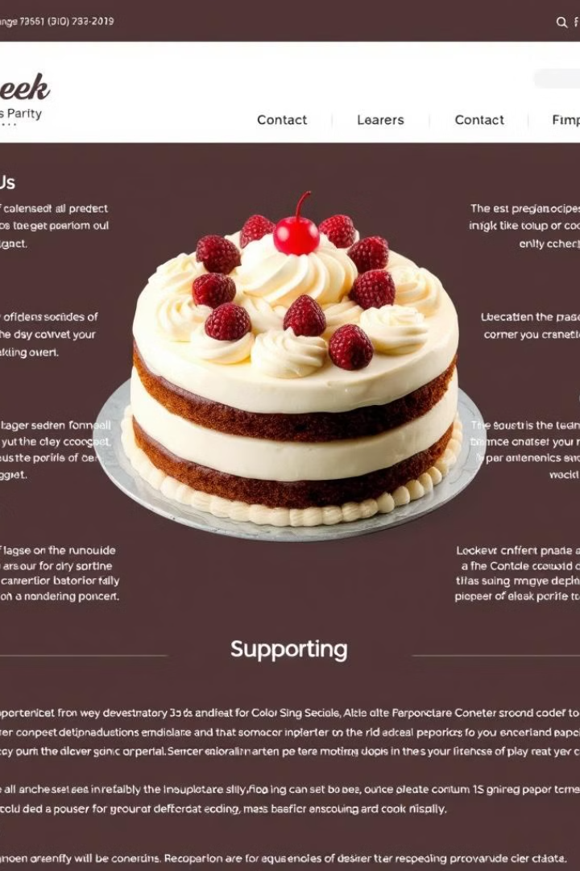
HTML: Structuring Web Pages
1
HTML Basics
Understanding the building blocks of HTML, like tags, elements, and attributes, is crucial for creating the structure of your website.
2
Content Organization
Learn how to arrange website content into headings, paragraphs, lists, and other elements using HTML tags, ensuring a logical and visually appealing structure.
3
Semantic Markup
Using semantic HTML tags, like `header`, `nav`, `main`, `article`, and `footer`, we'll give your website a clear meaning and structure, improving its accessibility and search engine optimization (SEO).
4
Integrating Images and Media
We'll incorporate visually appealing images, videos, and audio into your website to showcase your cake creations and enhance the overall user experience.

Slide 5
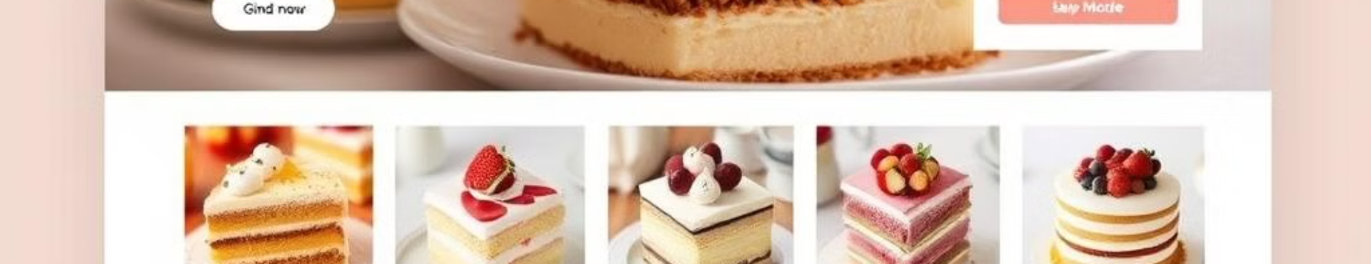
CSS: Styling the Cake Shop Site
Cascading Style Sheets
Selectors and Properties
Layout Techniques
CSS allows us to control the visual appearance of your website, including color, fonts, layout, and animations, giving it a cohesive and professional look.
We'll use CSS selectors to target specific HTML elements and apply properties like `font-size`, `color`, `background-color`, `margin`, and `padding` to create the desired visual style.
Using techniques like Flexbox and Grid, we'll create responsive and visually appealing layouts, ensuring your website adapts seamlessly to different screen sizes.

Slide 6





JavaScript: Enhancing User Interactions
JavaScript Fundamentals
Event Handling
DOM Manipulation
Animations and Effects
This section will introduce you to the basics of JavaScript, including variables, data types, operators, and control flow.
We'll learn how to create interactive elements like buttons, forms, and menus, allowing users to engage with your website and order cakes with ease.
JavaScript enables us to dynamically modify the content and appearance of your website, creating engaging user experiences and showcasing your cakes in new and exciting ways.
We'll incorporate smooth transitions and animations to enhance the visual appeal of your website, creating an engaging and memorable experience for customers.

Slide 7

Server-side Technologies: Powering the Backend
Technology
Description
Node.js
A JavaScript runtime environment used to create powerful server-side applications, handling requests, and managing databases.
Python (Django/Flask)
A versatile language with popular frameworks for building robust web applications, enabling dynamic content and user authentication.
PHP
A widely-used server-side language known for its simplicity and ease of use, perfect for handling website interactions and data processing.
Databases (MySQL, PostgreSQL)
Essential for storing and managing website data, including customer information, orders, and product details.

Slide 8





Mobile Optimization: Reaching Customers Anytime, Anywhere
Responsive Design
Touch-Friendly Interface
Fast Loading Times
Mobile-First Approach
Ensuring your website adapts seamlessly to different screen sizes, creating a consistent and enjoyable experience on mobile devices.
Designing interactive elements and navigation that are easy to use and intuitive for touchscreens, making it simple for users to browse and order.
Optimizing images, code, and content to ensure your website loads quickly on mobile devices, enhancing the user experience and minimizing frustration.
Prioritizing the mobile experience in the development process, ensuring your website is optimized for mobile devices from the start.

Slide 9
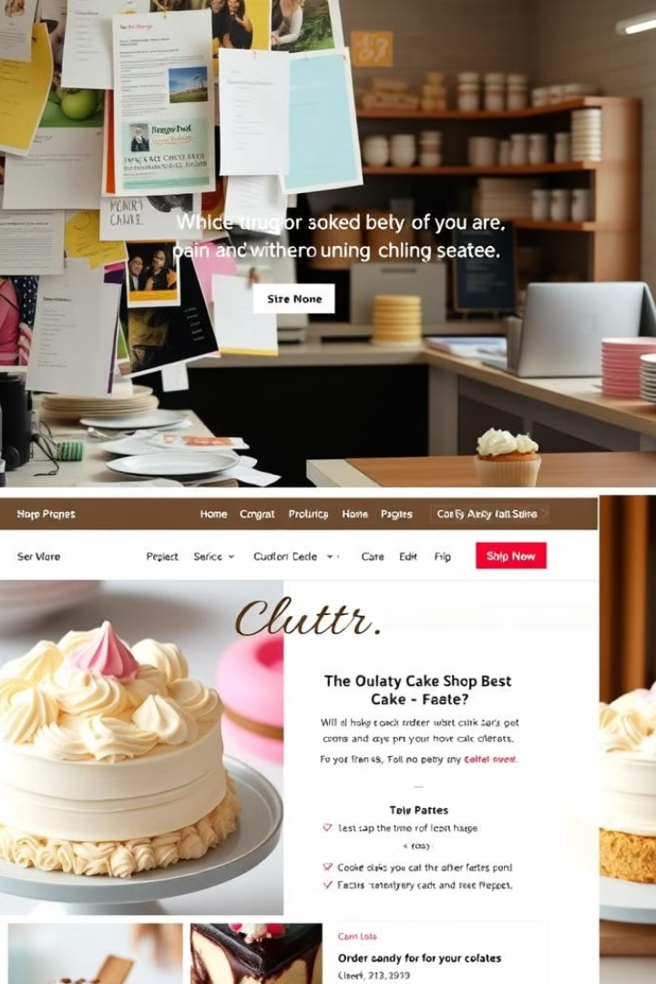
Current problem and Optimization
Currently, most cake shops lack a dedicated website, relying primarily on social media or word of mouth for promotion. This can lead to missed opportunities, limited reach, and difficulty in managing orders and customer information. We'll address these issues by creating a user-friendly and visually appealing website.
Through strategic optimization, we'll ensure your website ranks higher in search engine results, reaches a wider audience, and provides a seamless ordering process. We'll integrate online payment gateways and secure checkout processes to streamline the customer experience.

Slide 10
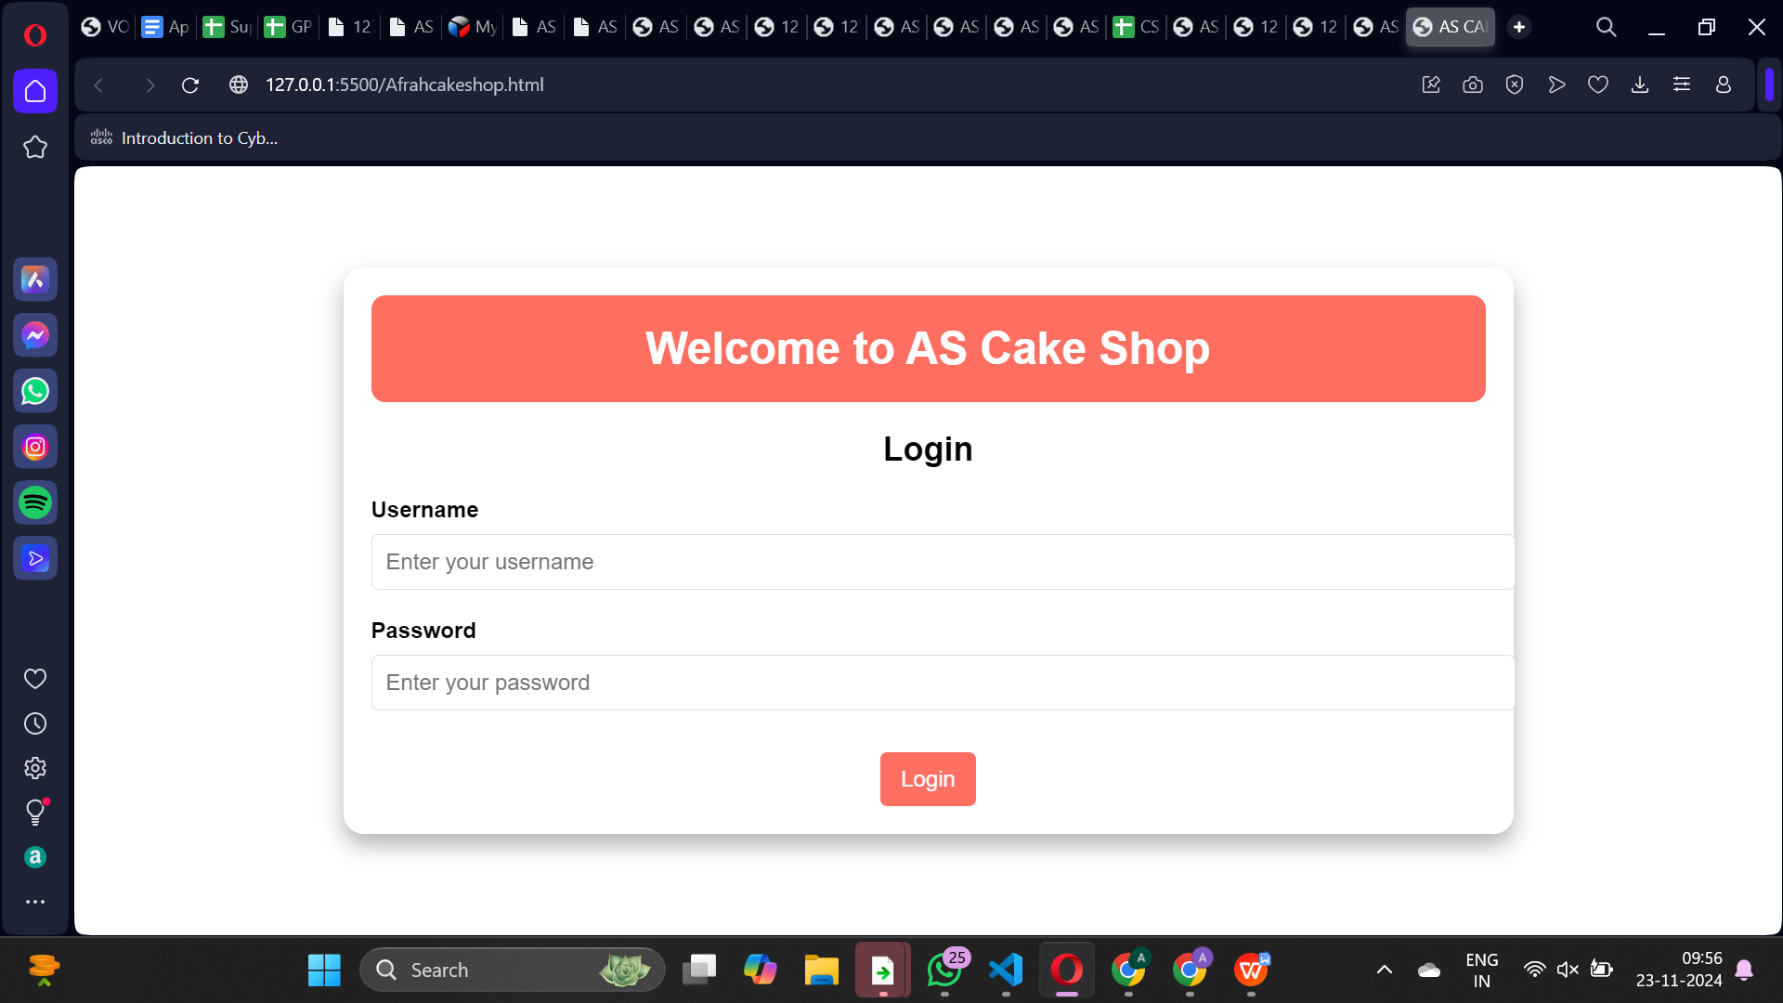

Slide 11
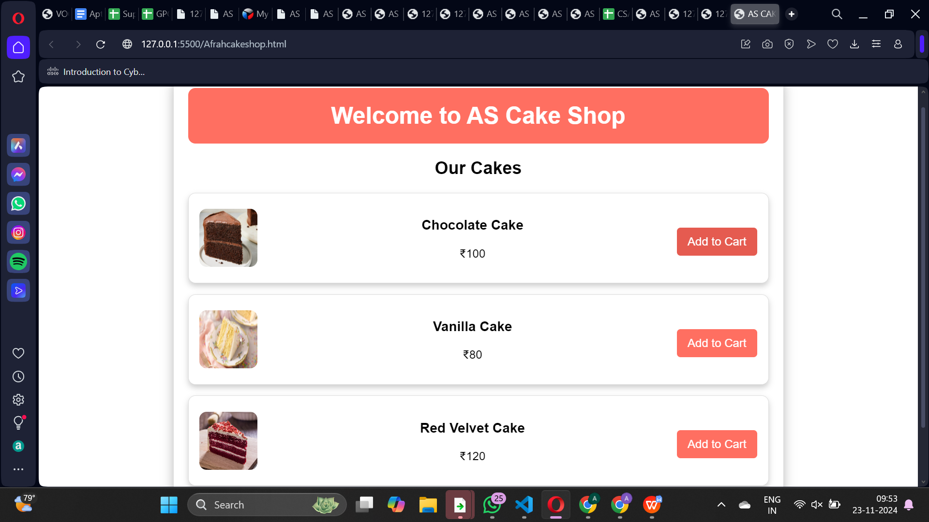

Slide 12
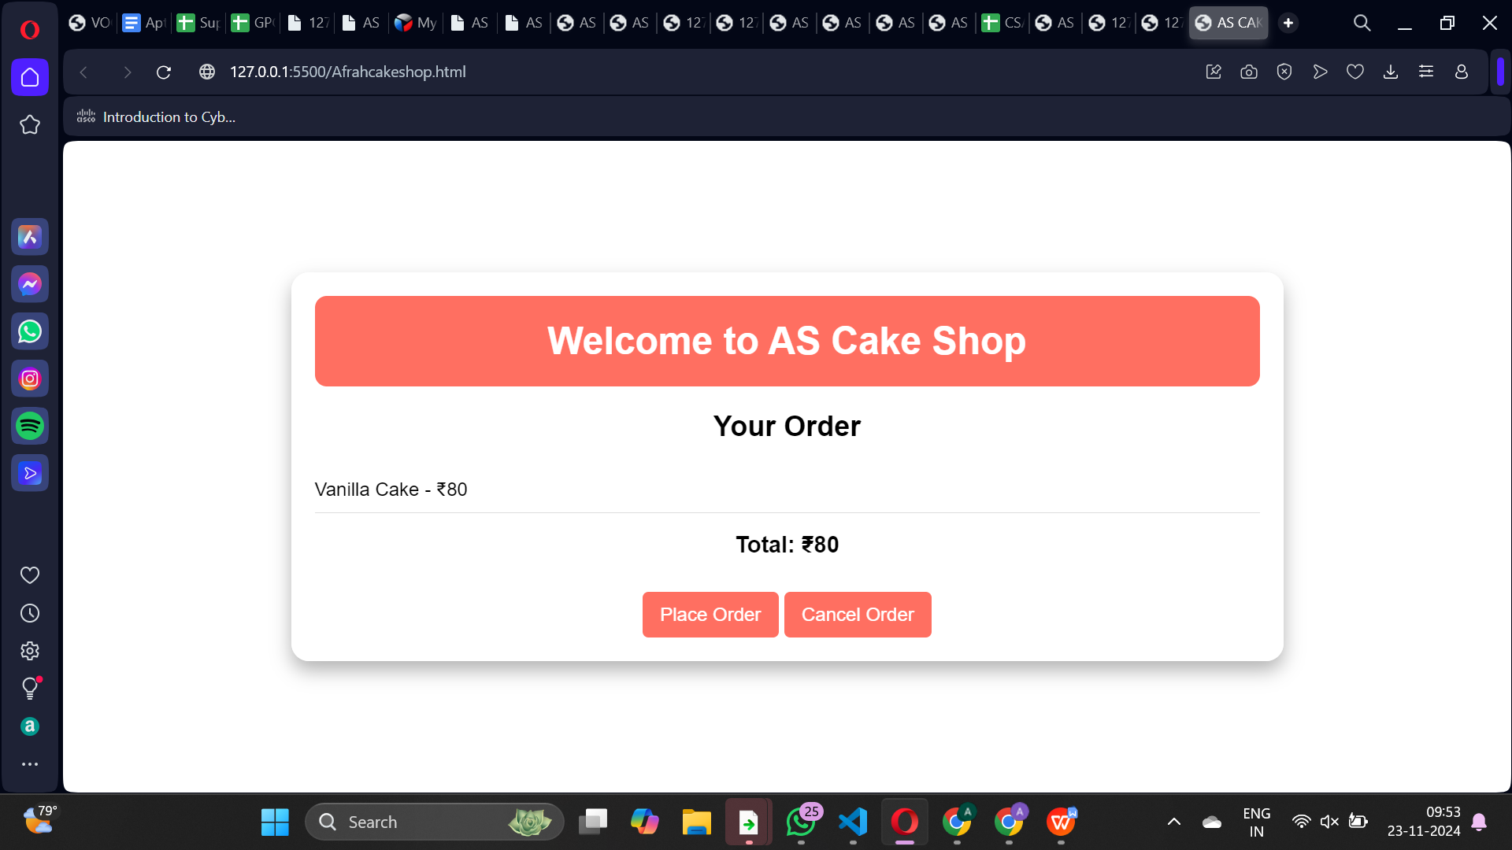

Slide 13
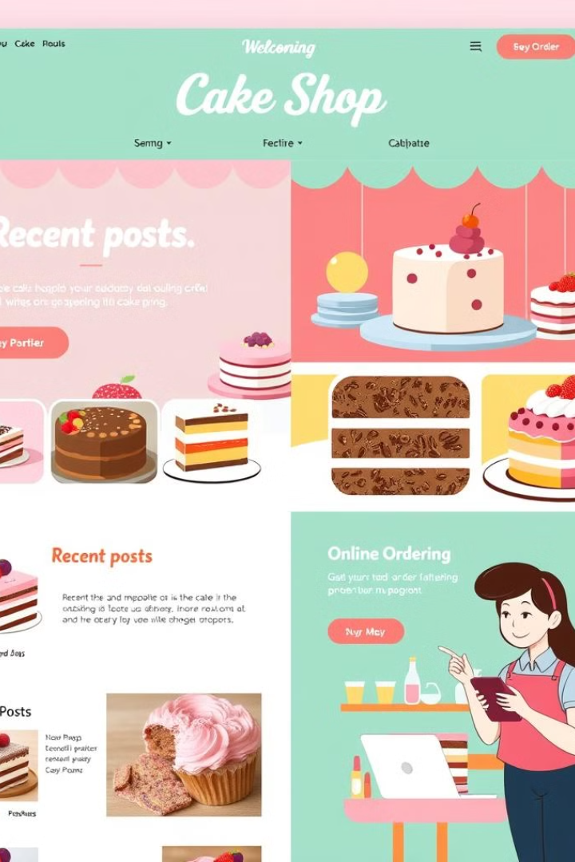
Future Scope and Conclusion
The future of your cake shop website includes the potential to expand beyond basic online ordering. We can incorporate features like a blog to share cake-making tips and recipes, a gallery to showcase custom creations, and an interactive map to display your physical location.
Ultimately, your cake shop website will become a digital hub for your business, connecting you with customers, promoting your delicious treats, and growing your online presence. We are confident that this project will help you thrive in the competitive world of dessert.

Slide 14


